Slide 1
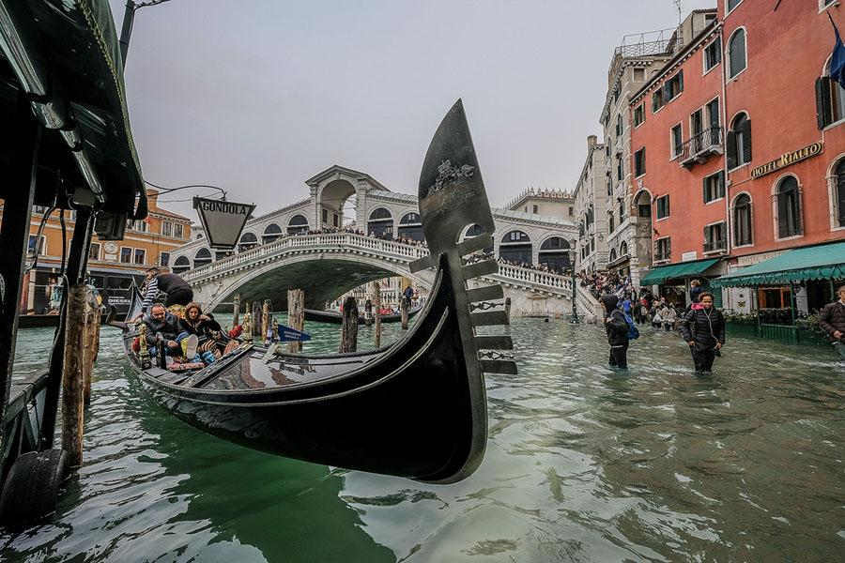
Acqua Alta
Macayla Bricarell, Carolyn Lok,
Christine Skofronick & Brittany Higginbotham

Slide 2
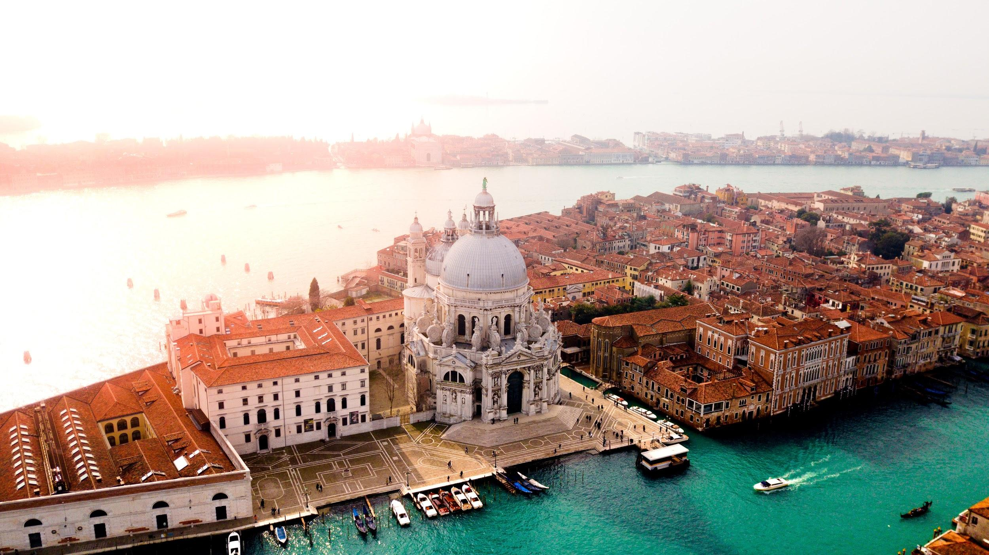
Pre-Crisis
Notes:
Macayla

Slide 3
We manage Italy’s cultural heritage and environment to ensure the protection of objects and places of interest and importance on the internal and national level.
Notes:
Macayla

Slide 4
Organization Background
Founded in late 1974 to consolidate similar activities
The organization was created to preserve historic monuments and Italian culture.
Today its responsibilities include promoting tourism in Italy as a major part of their GDP
Notes:
Macayla

Slide 5
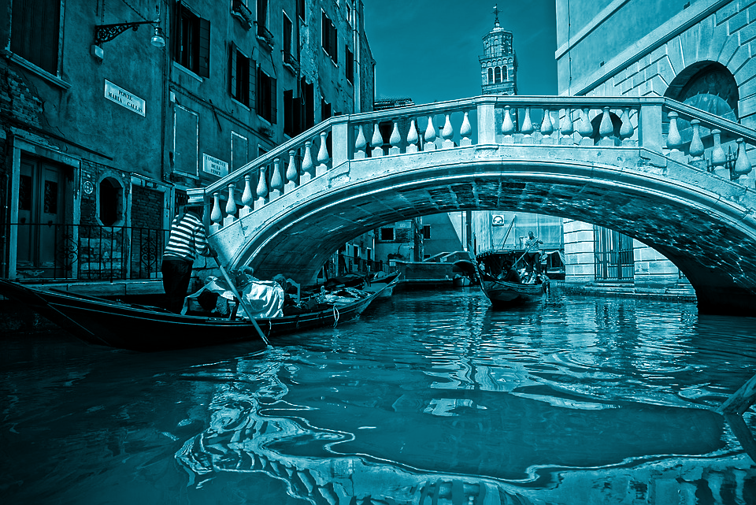
Why do people go to Venice?
A historic and romantic city featuring:
Famous gondola rides on the Grand Canal
Piazza San Marco (St. Mark’s Square)
Basilica di San Marco (St. Mark’s Basilica)
Palazzo Ducale (Doge’s Palace)
Best time to go?
Late spring through summer
Notes:
Macayla

Slide 6
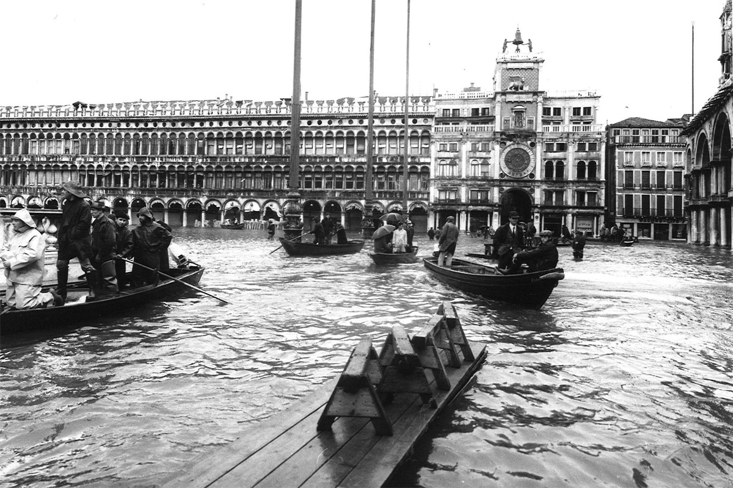
Historic Precedence
Venice is pulled down by four inches each century
Natural and unnatural processes have caused the sea level to rise
Ancient Venetians raised the ground level as much as six feet beginning in the fifth century
MOSE
The St. Mark’s Square flooded 20 times a year in the 1960s, today it floods 60 times a year. Credit: MOSE Venice
Notes:
Macayla

Slide 7
Audiences & Stakeholders
Venetians
Italians
Government employees
Local business owners
Future tourists
Notes:
Macayla

Slide 8
Pre-Crisis Preparation
Ongoing work to protect historical sites
MOSE
Docking cruise ships in new area
Alert system, with texts and sirens throughout the city to indicate level of flooding
Notes:
Macayla

Slide 9
Long-Term Crisis
Venice sinks four inches deeper into the ocean every century
Deaths in other Italian cities (i.e. Sicily)
Ongoing damage to historical sites
Future tourism
Notes:
Macayla

Slide 10
Long-Term Crisis
Venice sinks four inches deeper into the ocean every century
Deaths in other Italian cities (i.e. Sicily)
Ongoing damage to historical sites
Future tourism
Notes:
Macayla

Slide 11
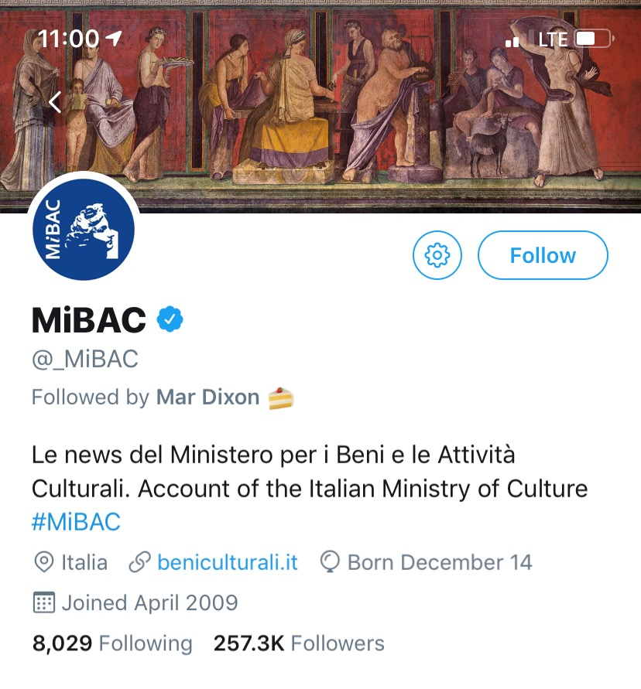
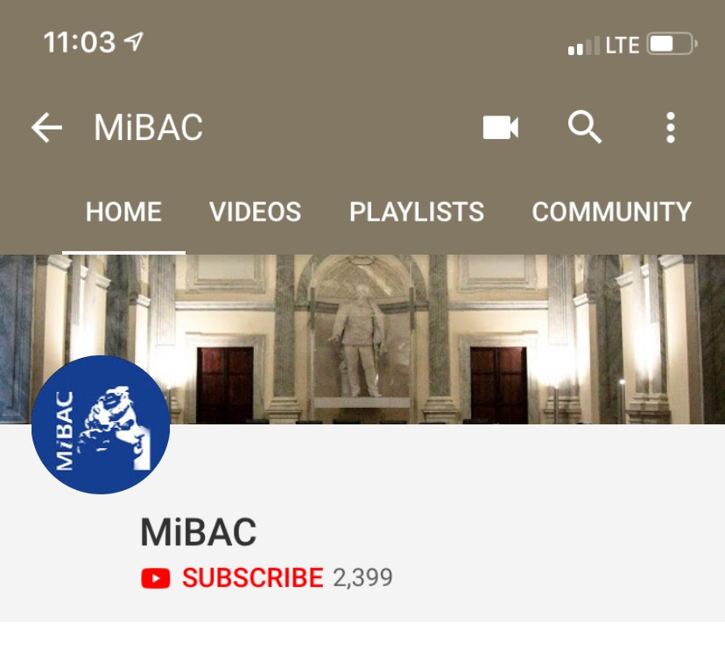
Social Media
Notes:
Brittany

Slide 12
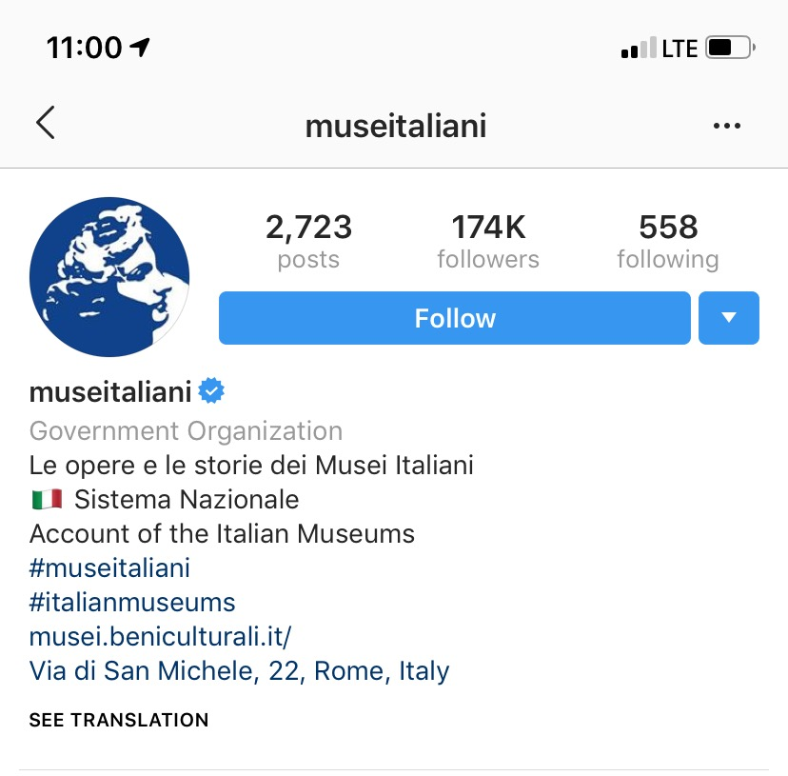
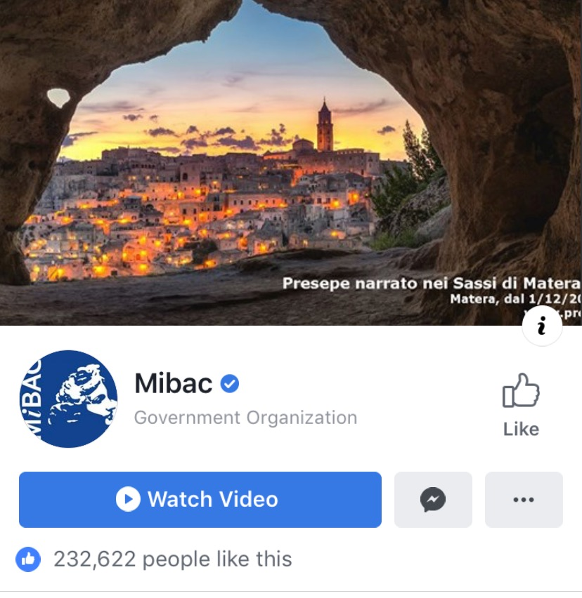
Social Media (cont’d)
Notes:
Brittany

Slide 13
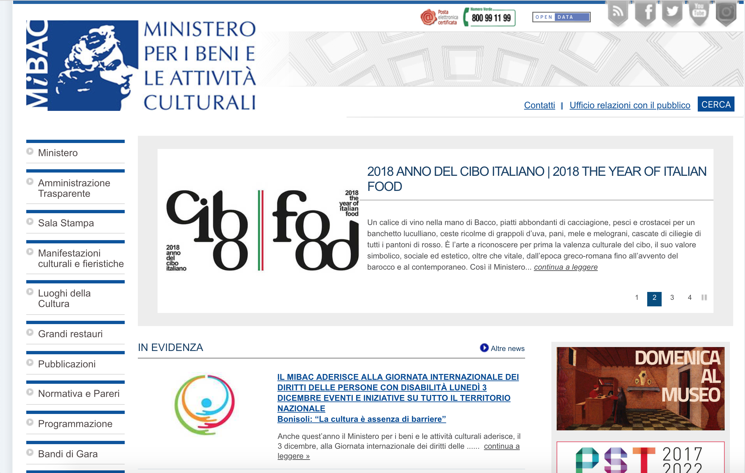
Website
Notes:
Brittany

Slide 14
Strengths
Weaknesses
Acknowledging problem
MOSE
Social media
MOSE
Opportunities
Threats
Rerouting tourists to lesser known attractions in Venice
Translation
Loss of revenue from tourism
Ancient architecture
Sewage problems
Notes:
Brittany

Slide 15
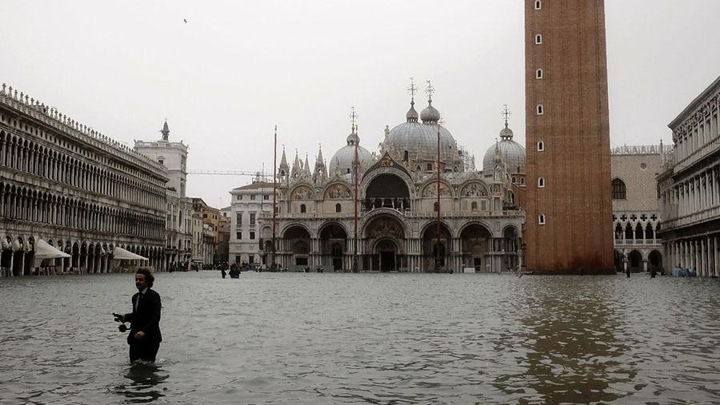
Crisis

Slide 16
Trigger Event
Over 5 feet of water flooded Venice on October 29, the highest levels in a decade.
The saltwater entered many historical buildings.
Major tourist attractions, including the Colosseum, Roman Forum and St. Mark’s Basilica were closed.
As of Nov. 4, up to 17 people were killed.
Contributes to the argument amongst experts who believe Venice will be gone by 2100.
Flooding is due to land subsidence causing the city to sink and climate change causing sea level to rise.
Notes:
Carolyn

Slide 17
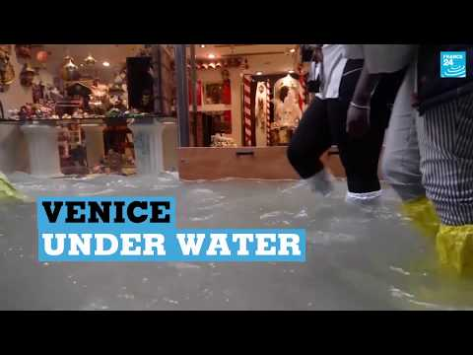
Floods didn’t stop tourists from immersing themselves in
Italian culture...
Notes:
Carolyn

Slide 18
Negative Impacts
Financial
Small businesses that rely on tourism
Infrastructure repairs
Environmental
14 million trees were destroyed
Ice in the ocean melting due to climate change leading to rise in sea levels
Reef damage
Notes:
Carolyn

Slide 19
Negative Impacts (cont’d)
Historical
Saltwater damage to culturally significant buildings and monuments
Ex: The St Mark’s Basilica was flooded for the second time in 100 years. The 1,000-year-old church was flooded with nearly 3 feet of water, aging the building by 20 years, causing potentially irreparable damage.
Public Health & Safety
Sewage in the floodwater
Resulting deaths
Food supply
Incoming winter
Notes:
Carolyn

Slide 20
Stakeholders & Affected Third Parties
Internal | External | Third Parties
Employees Venetians Italian citizens | Tourists People who work in the Venice tourism industry | Environmentalists Historians/researchers Other government agencies
Notes:
Carolyn

Slide 21
Research
Communicating with tourist information hubs
Consulting historical preservationists
Consulting building contractors and engineers
Consulting environmental experts and scientists
Constant communication with local Venice public officials
Notes:
Carolyn
Hubs to know what questions people are asking and want to know the answers to.

Slide 22
Crisis Team
Luigi Brugnaro, Mayor of Venice
Alberto Bonisoli, Minister
Corrado Azzollini, Regional Director for Veneto
Francesco Palumbo, Director of General Tourism Management
Daniele Ferrara, Regional Museum Director for Veneto
Emanuela Carpani, Archaeology Superintendent of of Fine Arts and Landscape for the Venice and Lagoon Region
Angelo Borrelli, Head of Italy’s Civil Protection Dept.
Roberta Rossiello, Public Relations Representative
Notes:
Carolyn

Slide 23
Strategy
We will use traditional and digital media channels to communicate our messages to our key audiences:
Venetians and Venetian businesses
Government employees
Tourists
We will also activate the premade dark site, built to address the common issues associated with flooding.
Notes:
Carolyn

Slide 24
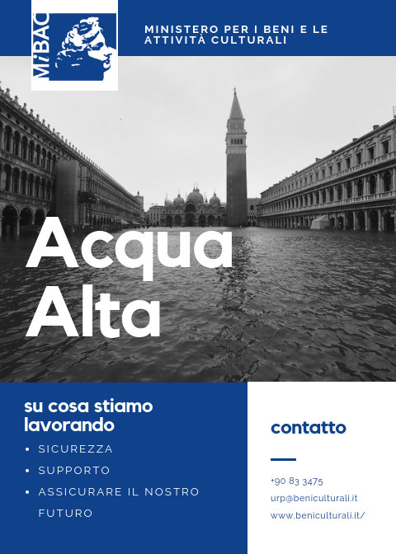
Central Messaging
Theme
“Safety, support and securing our future.”
Notes:
Christine

Slide 25
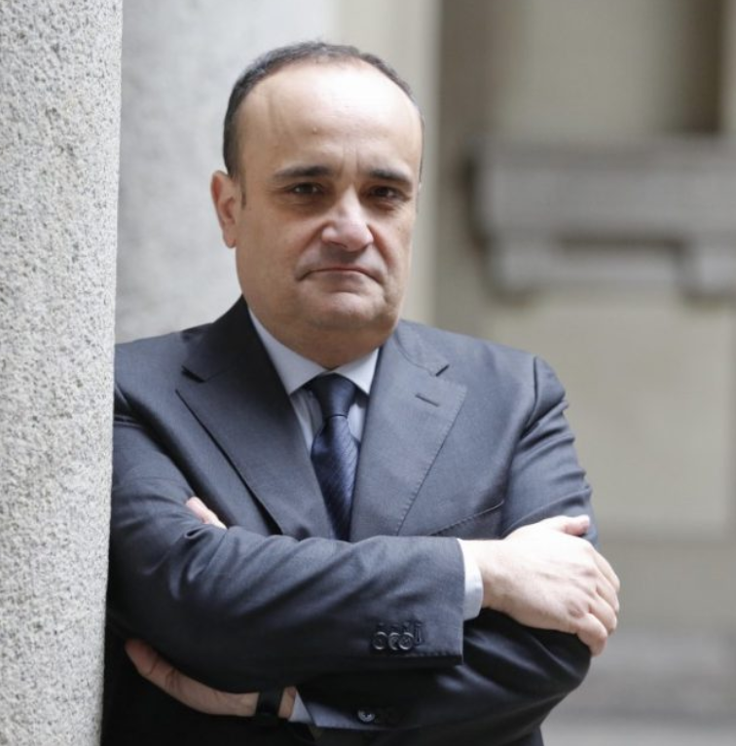
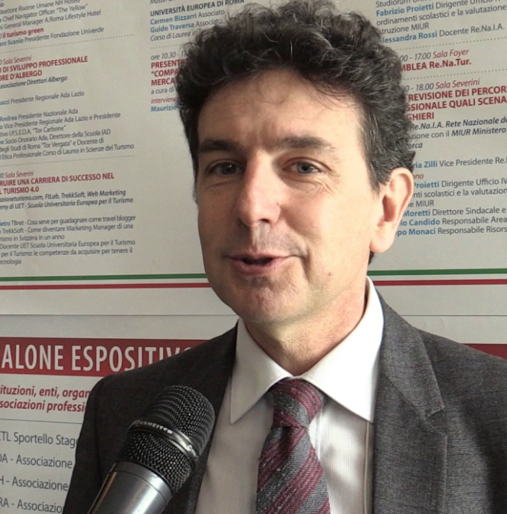
Spokespeople
Alberto Bonisoli, Minister
Francesco Palumbo, Director of General Tourism Management
Notes:
Christine

Slide 26
Initial Statement
“The Ministry of Cultural Heritage and Activities is currently working with local and national authorities, as well as a wide range of experts to monitor the damage done to historical sites and museums. Our heart goes out to the families of the victims. If you are in need of assistance, please contact local authorities at +39 066723.”
Alberto Bonisoli, Minister
Notes:
Christine

Slide 27
Media Distribution
Notes:
Christine

Slide 28
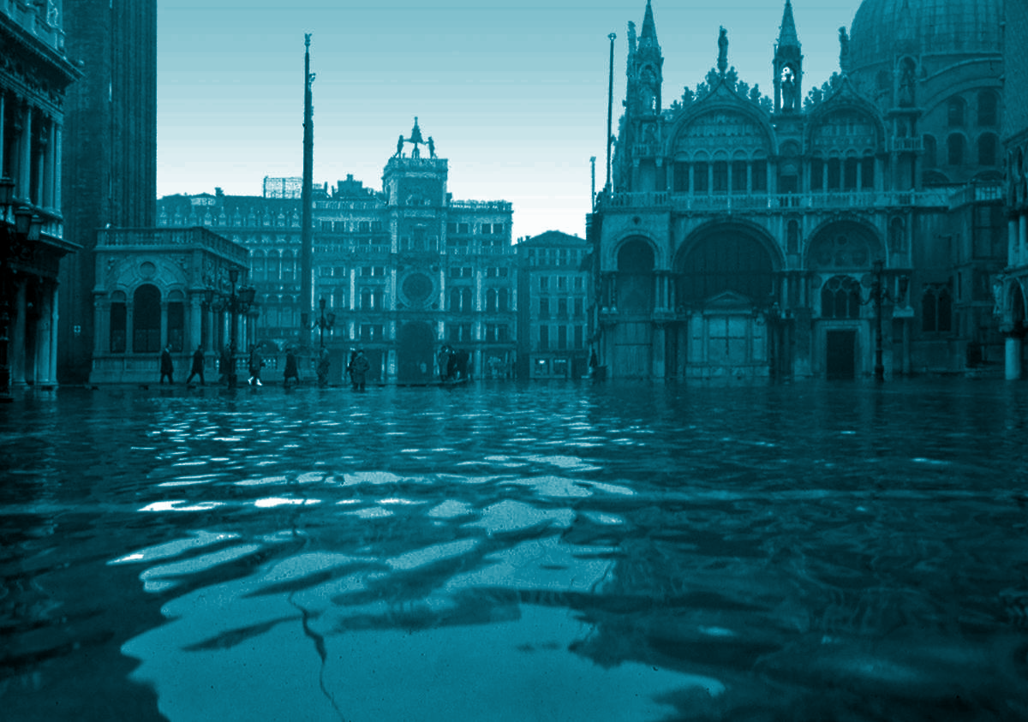
Venetians & Venetian Businesses
The floods directly and immediately affect the local citizens who are worried about the future of their city. Businesses that depend on tourism will also be concerned with how the floods will affect them.
Media channels that we will use to communicate with this audience will be:
Updates broadcasted on local news stations
Updates on social media channels
Government alerts (app, text messages, sirens)
A flooded St. Mark’s Square.
Credit: wmf.org
Notes:
Christine

Slide 29
Sample Statement
“As one of the main cultural hubs of Europe, we here at the Ministry of Cultural Heritage and Activities are working diligently to preserve the history of Venice. We acknowledge the concerns about the future of our city and are in contact with preservation experts to revive Venice to its former glory. We’re proud to say museums and galleries are back open. Furthermore, we are here to provide any additional support or information that may be required.”
Francesco Palumbo, Director of General Tourism Management
Live televised statement and shared on social platforms
Notes:
Christine

Slide 30
Government Employees
We must ensure there is constant communication between national and local government levels so no individual feels uninformed or blindsided as we work through the crisis.
Media channels that we will use to communicate with this audience will be:
Emails
Updates on social media channels
A flooded St. Mark’s Square.
Credit: wmf.org
Notes:
Christine

Slide 31
Sample Statement
“On behalf of the Ministry, I am incredibly proud of all the work our team is doing to restore and preserve the culture of Venice. We will provide updates as we receive them. In the meantime, continue following restoration protocols for flooding in the city center. Any questions may be directed toward our internal public relations team.”
Alberto Bonisoli, Minister
Email statement and shared on internal employee communication site.
Notes:
Christine

Slide 32
Tourists
Travel & tourism is more important to Venice’s economy than it is to the economy of Italy as a whole, contributing 11.6% of the city’s GDP. The number of tourists is increasing exponentially, averaging at 20 million tourists annually. Tourists that were present in Venice during the floods in October were forced to walk knee-deep through the flooded streets and seek refuge.
Media channels that we will use to communicate with this audience will be:
Updates on social media channels
Updates on the dark site
A flooded St. Mark’s Square.
Credit: wmf.org
Notes:
Christine

Slide 33
Sample Statement
“We strive to immerse visitors into our culture, and welcome them into our communities. We’re working to make sure present and future travels to Venice will not be affected by the current environmental conditions. As always, our highest priority is creating a positive and unforgettable experience for you. If there are any concerns or inquiries regarding your visit to our city, please visit our website at http://www.beniculturali.it/acquaalta/ or call us at +39 894355 for assistance.”
Francesco Palumbo, Director of General Tourism Management
Posts on all social media profiles with links back to dark site.
Notes:
Christine

Slide 34
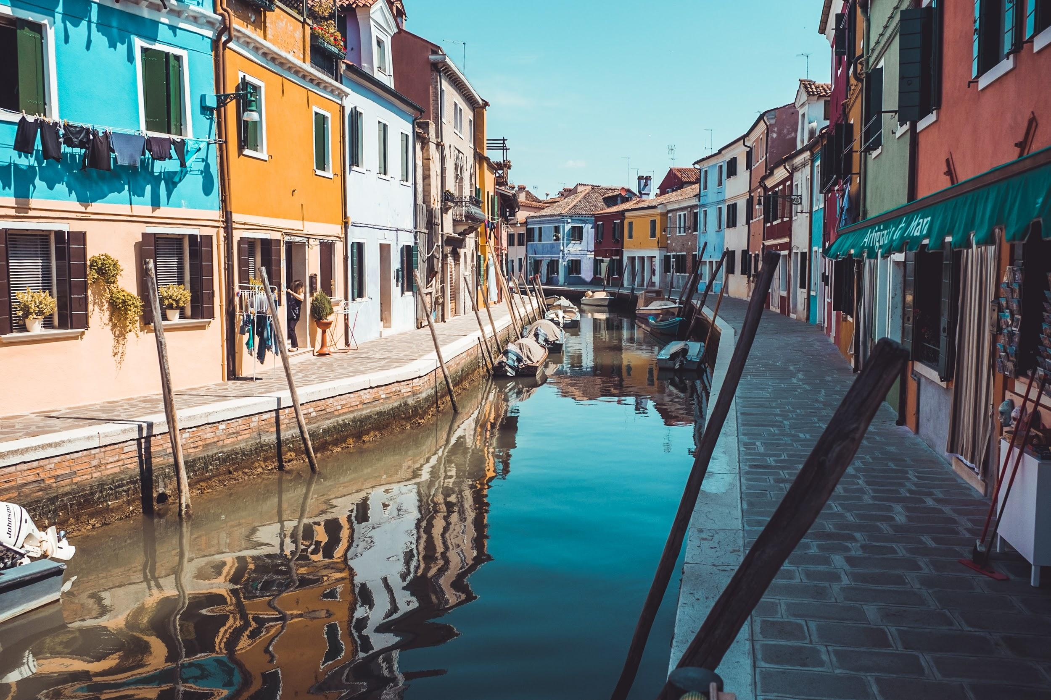
Post-Crisis

Slide 35
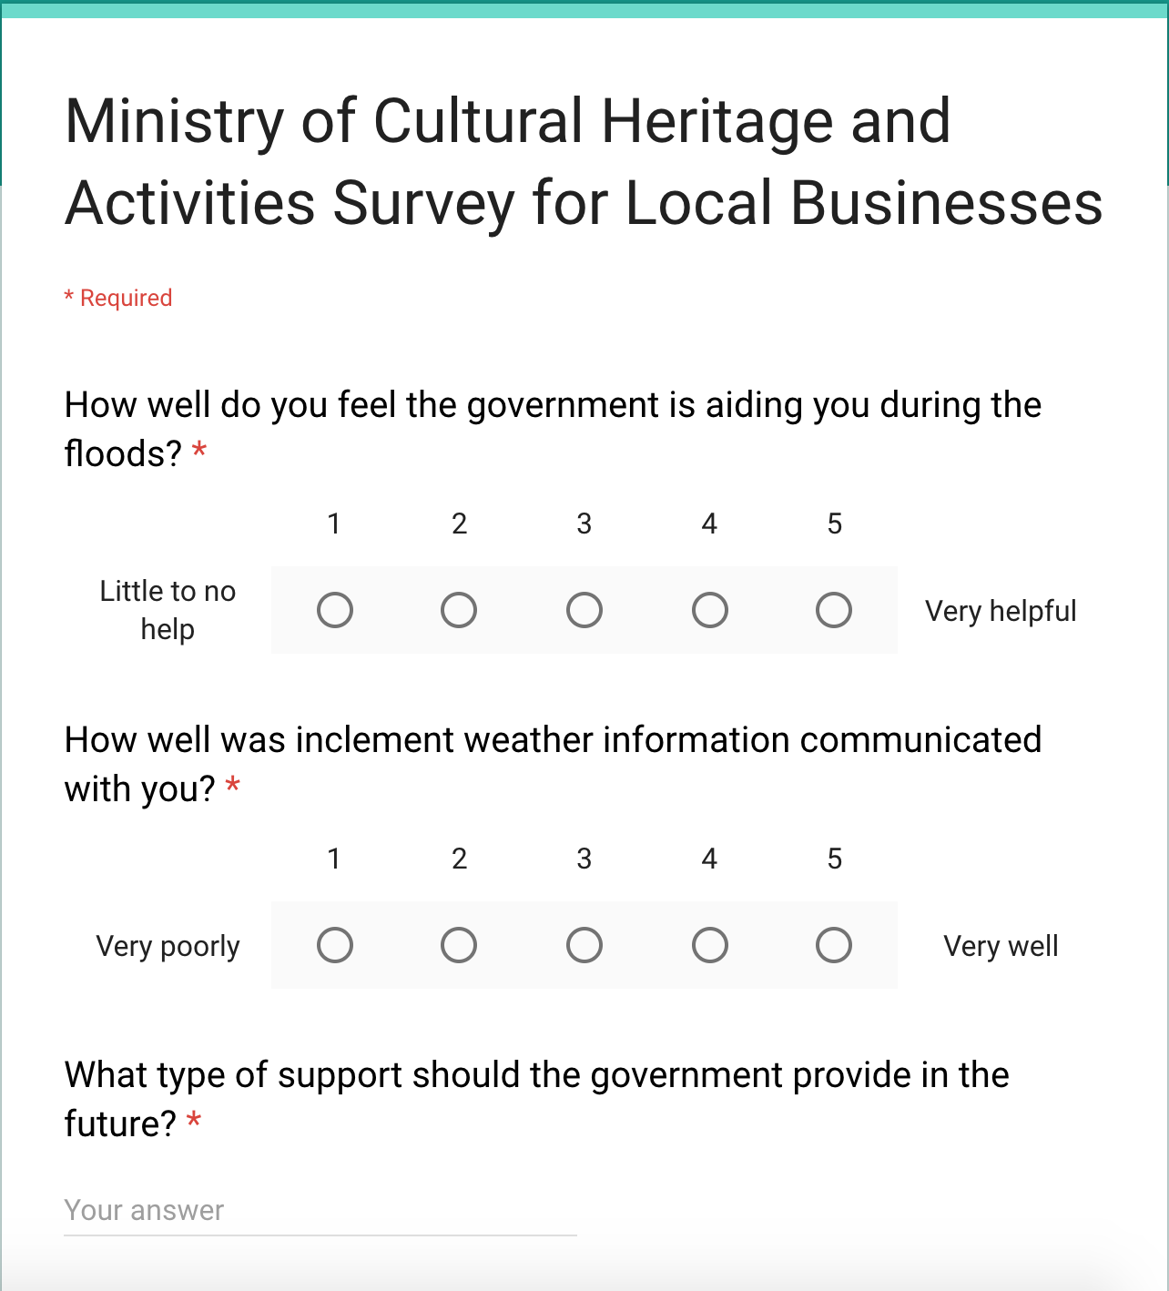
Evaluating Response
To evaluate how local businesses feel that the government has provided resources during the Acqua Alta events of 2018, and how we as a government entity can improve in future seasons, we will begin sending this survey to all businesses impacted by the weather.
Notes:
Brittany

Slide 36
Implementing Corrective Action
To prevent future damage, we will bring in experts to improve our infrastructure and restoration experts to prevent further damage to sites with cultural significance
Advocate for investment in ecological efforts to promote coral growth and decrease silt removal and increase in water levels
Provide residents with a directory of contractors to protect their property
Notes:
Brittany

Slide 37
Regaining Trust
Work to maintain the same amount of tourism entering Venice
Protect the sites that bring tourists to the city year after year
Notes:
Brittany

Slide 38
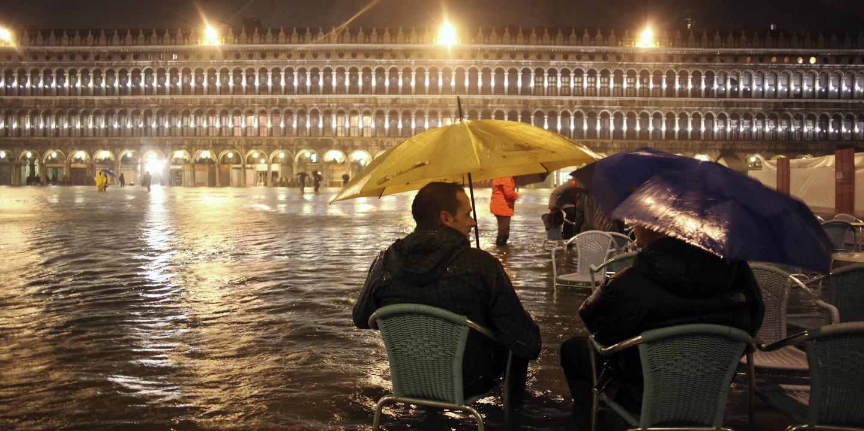
Questions?

Slide 39
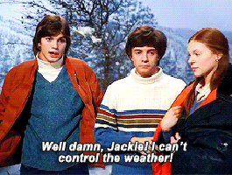
Notes:
Funding a swim team
Make Venice Dry Again #MVDA
Complementary flippers and scuba gear
#MakeAtlantisRealAgain
RIP our last three brain cells

Slide 40
Sources
https://www.independent.co.uk/news/world/europe/italy-floods-storm-landslide-deaths-river-sicily-forests-trees-destroyed-trentino-veneto-venice-a8616951.html
https://oceanservice.noaa.gov/facts/sealevelclimate.html
https://www.wttc.org/-/media/files/reports/economic-impact-research/cities-2017/venice2017.pdf
https://www.unsplash.com/
https://www.bu.edu/bostonia/fall14/lessons-from-venice/
https://www.pbs.org/newshour/show/climate-change-challenges-sinking-city-venice
https://www.beniculturali.it/mibac/export/MiBAC/index.html#&panel1-1
https://www.theatlantic.com/photo/2018/10/venice-under-water/574396/
https://www.nytimes.com/2018/10/30/world/europe/venice-floods-italy.html
https://www.lastampa.it/2017/10/12/esteri/venice-and-mose-story-of-a-failure-2XRaxsCgFhcmKEXidalyxJ/pagina.html
https://www.dw.com/en/venice-installs-turnstiles-to-limit-massive-tourist-flow/a-43578659
https://www.comune.venezia.it/it/archivio/74151
https://www.usnews.com/news/business/articles/2017-11-08/big-cruise-ships-visiting-venice-to-be-re-routed
https://www.usnews.com/news/business/articles/2017-11-08/big-cruise-ships-visiting-venice-to-be-re-routed
https://www.mosevenezia.eu/wikimose/
http://www.beniculturali.it/mibac/export/MiBAC/index.html#&panel1-4

